Slide 1


Digital Transformation for a Drug Manufacturing Firm Using Oracle SCM
Team Members:
Aalaa Mohamed Ahmed
Ahmad Omar Yosuf
Almahmoud Gamal Mahmoud
Hisham Ahmed Ramadan
Mohamed Ahmed Mohamed
Safwat Saadeldin Elsebaie

Slide 2
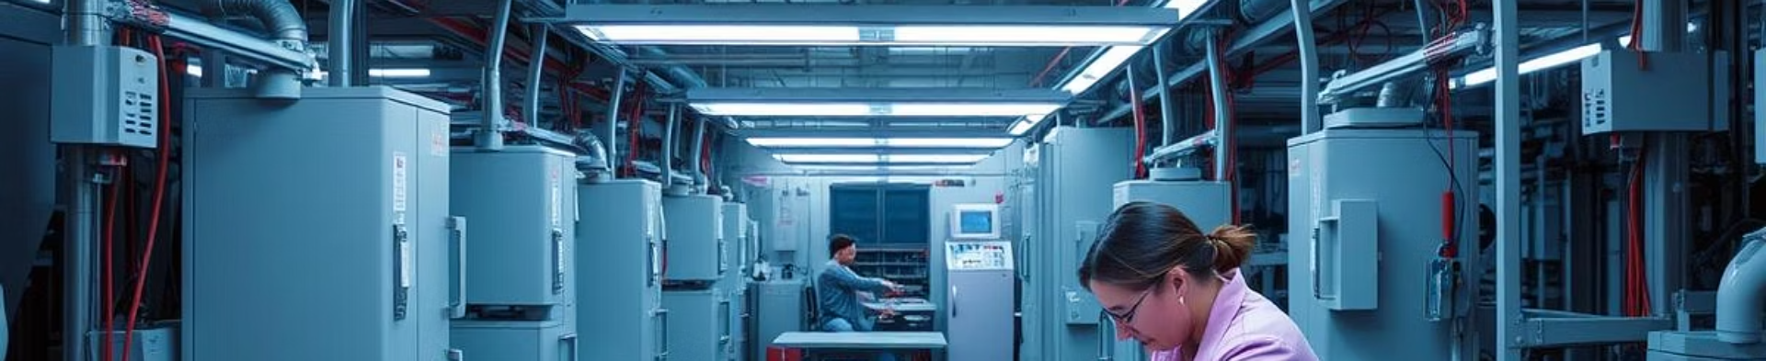
Project Background and Challenges
Manual Operations
Disconnected Systems
Inventory Tracking Issues
Lead to errors, delays, and compliance risks impacting product quality.
Fragmented data hampers real-time visibility and decision-making.
Difficulties in accurately tracking inventory and production status.

Slide 3



Digital Transformation with Oracle SCM
Unified Supply Chain View
Automation
Compliance
Seamless visibility across procurement, production, and sales operations.
Efficiently streamlining procurement, production, inventory, and sales workflows.
Robust reporting ensures adherence to regulations and quality standards.

Slide 4

Implementation Scope
Main Factory
Storage Center
Focus on digitalizing the core manufacturing processes located in Cairo.
Optimize inventory management at the Alexandria warehouse facility.
Oracle Best Practices
Deploy standard SCM frameworks and proven methodologies for implementation.

Slide 5


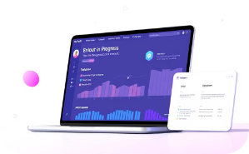



Project Roadmap
Assessment
Design
Initial Rollout
Training
Evaluate current systems and define key requirements.
Create solution blueprint aligned with business goals.
Deploy core Oracle SCM modules for pilot use.
Equip staff with operational knowledge and skills.
Go-Live
Future Expansion
Full production launch with ongoing support.
Scale system to additional locations and features.

Slide 6
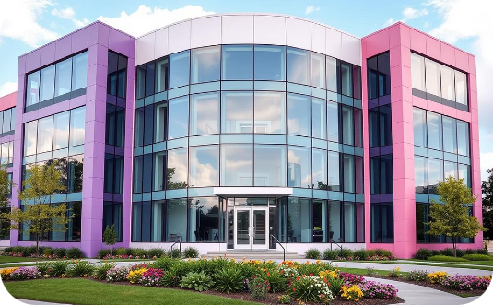
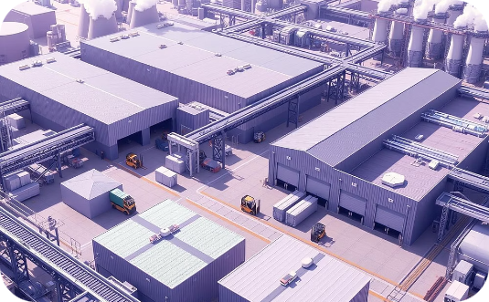

Organizational Design in Oracle SCM
Business Groups & Legal Entities
Operating Units & Locations
Job Roles & Responsibilities
Including plants and storage centers for operational clarity.
Mapped to manage access and workflow assignments.
Reflecting corporate and regulatory structures.

Slide 7

Inventory Setup and Management
Warehouse & Subinventories
Lot & Serial Tracking
Ensures traceability from receipt to shipment.
Structured for precise location tracking and management.
Inventory Controls
ABC classification and min-max planning for optimized stock levels.

Slide 8
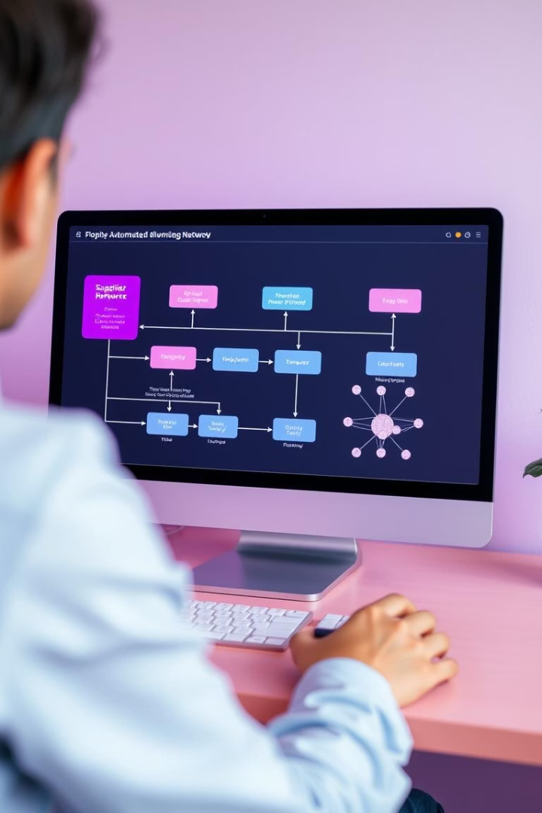
Procurement Process Automation
Supplier Hub Onboarding
Centralize supplier data and qualifications management.
Automated Requisition
Trigger purchase orders based on inventory needs.
Receiving & Inspection
Streamline acceptance and quality control processes.

Slide 9
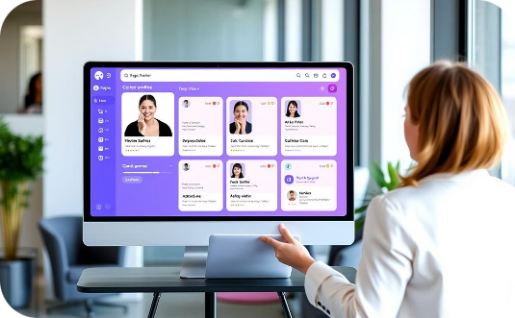

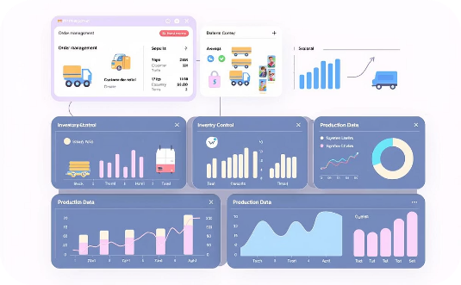
Sales and Order Management Integration
Customer Management
Order to Invoicing
Full Integration
Maintain detailed profiles and histories for each customer.
Automate workflows for picking, shipping, and billing.
Synchronize order data with inventory and production planning systems.

Slide 10




Achievements and Benefits
Inventory Accuracy
Errors Reduced
Compliance Improved
Faster Decision-Making
Minimized operational mistakes via automated workflows
Significantly increased through precise tracking and controls
Strengthened adherence to regulatory standards
Enabled real-time insights for quick responsive actions

Slide 11
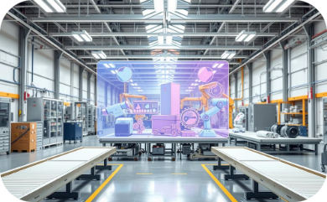
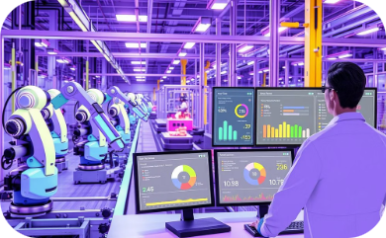
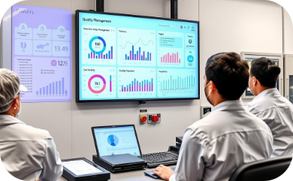

Future Roadmap for Expansion
Factory 1
Factory 2
Factory 3
Full Digital Ecosystem
Core Oracle SCM modules for foundational processes
Integration with MES for real-time production control
Deploy Quality Cloud solutions for compliance and traceability
AI-powered analytics for continuous improvement

